Slide 1


Chapter
7
Hypothesis Testing with One Sample

Slide 2
Chapter Outline
7.1 Introduction to Hypothesis Testing
7.2 Hypothesis Testing for the Mean (σ Known)
7.3 Hypothesis Testing for the Mean (σ Unknown)
7.4 Hypothesis Testing for Proportions
7.5 Hypothesis Testing for Variance and Standard
Deviation
.

Slide 3
Section 7.5
Hypothesis Testing for Variance and Standard Deviation
.

Slide 4
Section 7.5 Objectives
How to find critical values for a χ²-test
How to use the χ²-test to test a variance or a standard deviation
.

Slide 5
Finding Critical Values for the χ²-Test
Specify the level of significance α.
Determine the degrees of freedom d.f. = n – 1.
The critical values for the χ²-distribution are found in Table 6 of Appendix B. To find the critical value(s) for a
  right-tailed test, use the value that corresponds to d.f. and α.
  left-tailed test, use the value that corresponds to d.f. and
  1 – α.
  two-tailed test, use the values that corresponds to d.f. and ½α and d.f. and 1 – ½α.
.

Slide 6






Finding Critical Values for the χ²-Test
Right-tailed
Left-tailed
1 – α
1 – α
χ²
χ²
Two-tailed
1 – α
χ²
.

Slide 7


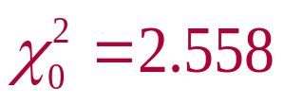
Example: Finding Critical Values for χ²
Find the critical χ²-value for a left-tailed test when
n = 11 and α = 0.01.
Solution:
Degrees of freedom: n – 1 = 11 – 1 = 10 d.f.
The area to the right of the critical value is
1 – α = 1 – 0.01 = 0.99.
χ²
From Table 6, the critical value is .
.

Slide 8
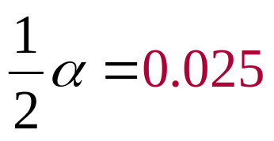
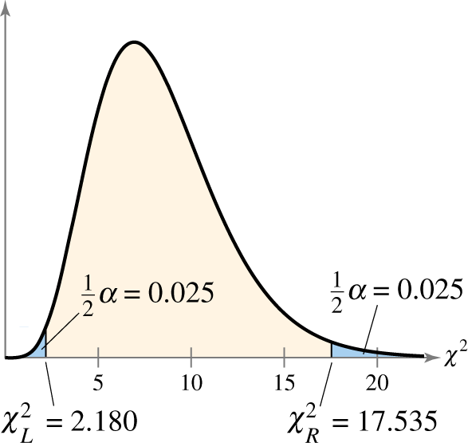
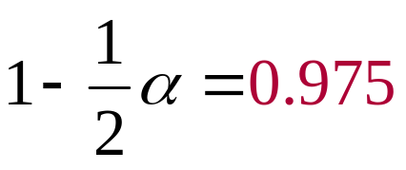

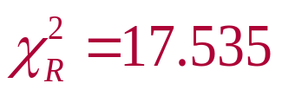
Example: Finding Critical Values for χ²
Find the critical χ²-values for a two-tailed test when n = 9 and α = 0.05.
Solution:
Degrees of freedom: n – 1 = 9 – 1 = 8 d.f.
The areas to the right of the critical values are
From Table 6, the critical values are and
.

Slide 9
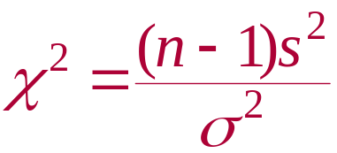
The Chi-Square Test
χ²-Test for a Variance or Standard Deviation
A statistical test for a population variance or standard deviation.
Can only be used when the population is normal.
The test statistic is s².
The standardized test statistic
follows a chi-square distribution with degrees of freedom d.f. = n – 1.
.

Slide 10
Using the χ²-Test for a Variance or Standard Deviation
In Words In Symbols
Verify that the sample is random and the population is normally distributed.
State the claim mathematically and verbally. Identify the null and alternative hypotheses.
Specify the level of significance.
Determine the degrees of freedom.
Determine any critical value(s).
State H₀ and H_{a}.
Identify α.
d.f. = n – 1
Use Table 6 in Appendix B.
.

Slide 11
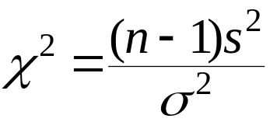
Using the χ²-Test for a Variance or Standard Deviation
In Words In Symbols
Determine any rejection region(s).
Find the standardized test statistic and sketch the sampling distribution .
Make a decision to reject or fail to reject the null hypothesis.
Interpret the decision in the context of the original claim.
If χ² is in the rejection region, reject H₀. Otherwise, fail to reject H₀.
.

Slide 12

Example: Hypothesis Test for the Population Variance
A dairy processing company claims that the variance of the amount of fat in the whole milk processed by the company is no more than 0.25. You suspect this is wrong and find that a random sample of 41 milk containers has a variance of 0.27. At α = 0.05, is there enough evidence to reject the company’s claim? Assume the population is normally distributed.
.

Slide 13
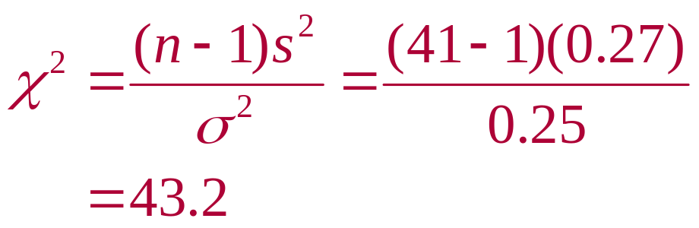

Solution: Hypothesis Test for the Population Variance
σ² ≤ 0.25
H₀:
H_{a}:
α =
d.f. =
Rejection Region:
Test Statistic:
Decision:
σ² > 0.25
0.05
41 – 1 = 40
Fail to Reject H₀
At the 5% level of significance, there is not enough evidence to reject the company’s claim that the variance of the amount of fat in the whole milk is no more than 0.25.
χ²
55.758
55.758
43.2
.

Slide 14
Example: Hypothesis Test for the Standard Deviation
A company claims that the standard deviation of the lengths of time it takes an incoming telephone call to be transferred to the correct office is less than 1.4 minutes. A random sample of 25 incoming telephone calls has a standard deviation of 1.1 minutes. At α = 0.10, is there enough evidence to support the company’s claim? Assume the population is normally distributed.
.

Slide 15
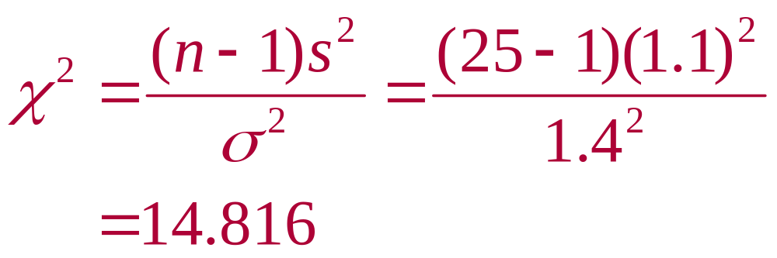
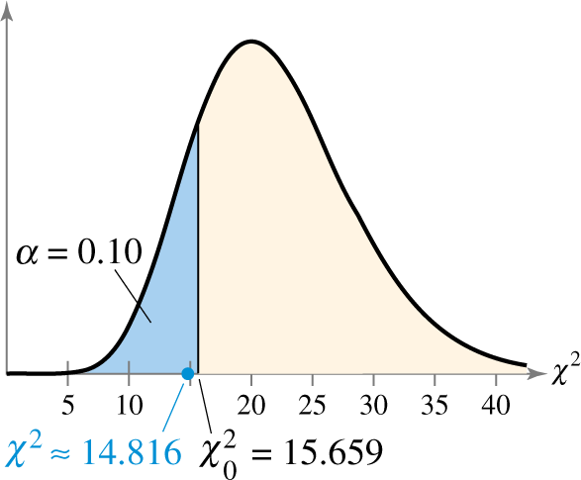
Solution: Hypothesis Test for the Standard Deviation
Test Statistic:
Decision:
σ ≥ 1.4 min.
H₀:
H_{a}:
α =
df =
Rejection Region:
σ < 1.4 min.
0.10
25 – 1 = 24
Reject H₀
At the 10% level of significance, there is enough evidence to support the claim that the standard deviation for lengths of time it takes an incoming telephone call to be transferred to the correct office is less than 1.4 minutes.
.

Slide 16

Example: Hypothesis Test for the Population Variance
A sporting goods manufacturer claims that the variance of the strength in a certain fishing line is 15.9. A random sample of 15 fishing line spools has a variance of 21.8. At α = 0.05, is there enough evidence to reject the manufacturer’s claim? Assume the population is normally distributed.
.

Slide 17
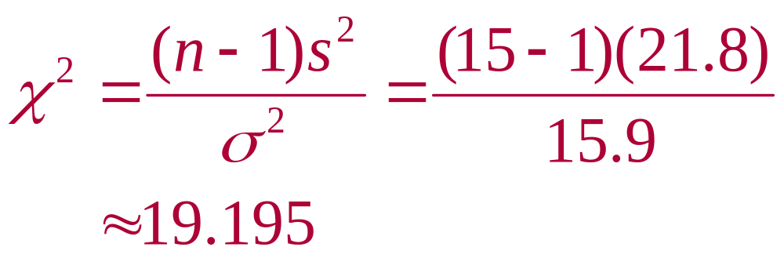
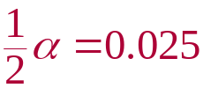
Solution: Hypothesis Test for the Population Variance
σ² = 15.9
H₀:
H_{a}:
α =
df =
Rejection Region:
Test Statistic:
Decision:
σ² ≠ 15.9
0.05
15 – 1 = 14
Fail to Reject H₀
At the 5% level of significance, there is not enough evidence to reject the claim that the variance in the strength of the fishing line is 15.9.
χ²
5.629
26.119
5.629
26.119
19.195
.

Slide 18
Section 7.5 Summary
Found critical values for a χ²-test
Used the χ²-test to test a variance or a standard deviation
.

